Slide 1
Data Analytics – Lesson 07 Naïve Bayes Classifiers using R
Jeffrey Strickland, Ph.D., CMSP, ASEP
CEO Humalytica Analytics

Slide 2
Naïve Bayes Classifiers
Naïve Bayes classifiers are a family of simple probabilistic classifiers based on applying Bayes’ theorem with strong (naïve) independence assumptions between the features
Naïve Bayes is a popular (baseline) method for text categorization, the problem of judging documents as belonging to one category or the other (such as spam or legitimate, sports or politics, etc.) with word frequencies as the features.
A Naïve Bayes classifier assumes that the value of a particular feature is unrelated to the presence or absence of any other feature, given the class variable
For example, a fruit may be considered to be an apple if it is red, round, and about 3” in diameter.
A Naïve Bayes classifier considers each of these features to contribute independently to the probability that this fruit is an apple, regardless of the presence or absence of the other features.

Slide 3
Gender classification – Naïve Bayes
Problem: classify whether a given person is a male or a female based on the measured features. The features include height, weight, and foot size
Training
Example training set on the right
gender | height (m) | weight (kg) | foot size (cm)
male | 1.8 | 81.6 | 30
male | 1.8 | 86.2 | 28
male | 1.7 | 77.1 | 30
male | 1.8 | 74.8 | 25
female | 1.5 | 45.4 | 15
female | 1.7 | 68.0 | 20
female | 1.7 | 59.0 | 18
female | 1.8 | 68.0 | 23

Slide 4
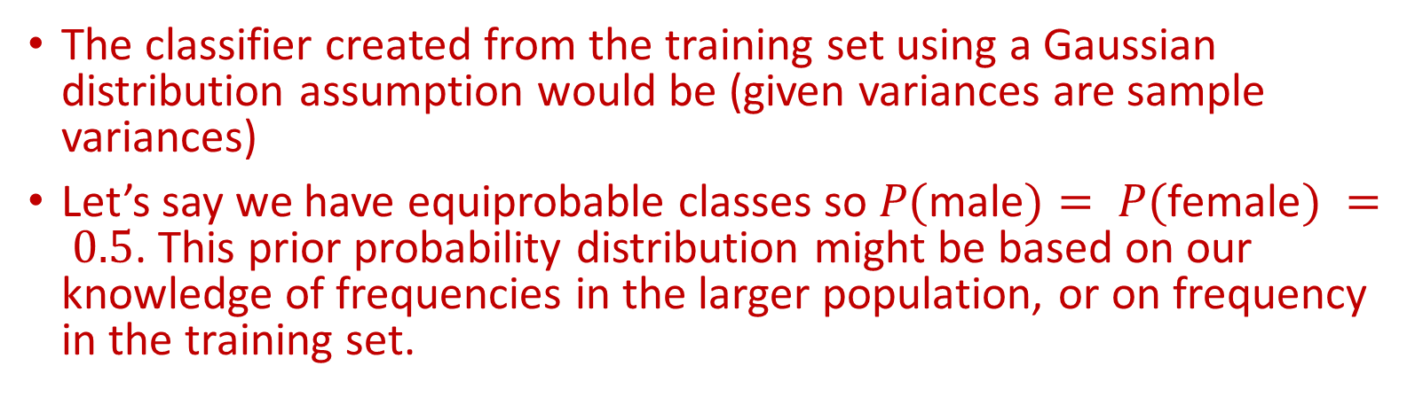
Gender classification – Naïve Bayes
The classifier created from the training set using a Gaussian distribution assumption would be (given variances are sample variances)
Let’s say we have equiprobable classes so $P(\text{male})= P(\text{female}) = 0.5$. This prior probability distribution might be based on our knowledge of frequencies in the larger population, or on frequency in the training set.
gender | mean (height) | variance (height) | mean (weight) | variance (weight) | Mean (foot size) | Variance (foot size)
male | 1.8 | 0.0033 | 79.9 | 25.29 | 28.6 | 5.91
female | 1.7 | 0.0090 | 60.1 | 114.87 | 19.1 | 10.75

Slide 5
Gender classification – Naïve Bayes
Testing
On the right is a sample to be classified as a male or female.
We wish to determine which posterior is greater, male or female.
gender | height (m) | weight (kg) | foot size (cm)
sample | 1.8 | 59 | 20

Slide 6

Text Classification
Assigning subject categories, topics, or genres
Spam detecton
Authorship identification
Age/gender identification
Language Identification
Sentiment analysis
Supervised Learning using Naïve Bayes
Definition
Input:
a document $d$
a fixed set of classes $C=\left\{c_{1}, c_{2},…, c_{J}\right\}$
A training set of m hand-labeled documents $\left(d_{1},c_{1}\right),….,\left(d_{m},c_{m}\right)$
Output:
a predicted class $c∈C$
a learned classifier $γ:d→c$

Slide 7


Bag of Words
If you choose any height along the y-axis of the dendrogram, and move across the dendrogram counting the number of lines that you cross, each line represents a group that was identified when objects were joined together into clusters. The observations in that group are represented by the branches of the dendrogram that spread out below the line. For example, if we look at a height of 60, and move across the x-axis at that height, we'll cross two lines.
$$γ$$
$$=c$$

Slide 8
Bag of Words Representation
If you choose any height along the y-axis of the dendrogram, and move across the dendrogram counting the number of lines that you cross, each line represents a group that was identified when objects were joined together into clusters. The observations in that group are represented by the branches of the dendrogram that spread out below the line. For example, if we look at a height of 60, and move across the x-axis at that height, we'll cross two lines.
$$γ$$
$$=c$$

Slide 9
Bag of Words Representation: Subsets of Words
xxxxxx choose xxx height xxxxxxxx xxxxxxxxxxxxxxxxx dendrogram xxxx xxxxxxxxxxxxxxx dendrogram xxxxxx xxxxxxxxxxxxxxxxxxxxxx line xxxxx xxx cross xxxxx line represent xx group xxxxxxxxxxxxxxxxxxxxxxxxxxx object xxxxx joined xxxxxxxxxxxxx clusters xxxxxxxxxxxxxxxxxxxxxxxx xxxx group xxx represent xxxxxxxx xxxxxxxxxxxxxxx dendrogram xxxxxx xxxxxxxxxxxxxx line xxxxxxxxxxxxx xxxxxxxxxxxxx height xxxxxxxxxxxx xxxxxx object xxxxxxxxxxxxxxxxxxx height xxxxxx cross xxx line xxxx
$$γ$$
$$=c$$

Slide 10
Bag of Words Representation
height | 3
dendogram | 3
line | 4
represent | 2
joined | 1
cross | 2
counting | 1
choose | 1
… | …
$$γ$$
$$=c$$

Slide 11


Bag of Words Assumption
Word position (order) does not matter
Feature probabilities P(x|c) are independent given the class of c:
$P(x_{1},…, x_{n}|c)=P(x_{1}|c)∙$ $P\left(x_{2} | c\right)∙…∙$ $P(x_{n}|c)$
$$Bayes Theorem: P(A|B)=\frac{P\left(B | A\right)P(A)}{P\left(B | A\right)P\left(A\right)+P\left(B | ¬A\right)P(¬A)}$$

Slide 12
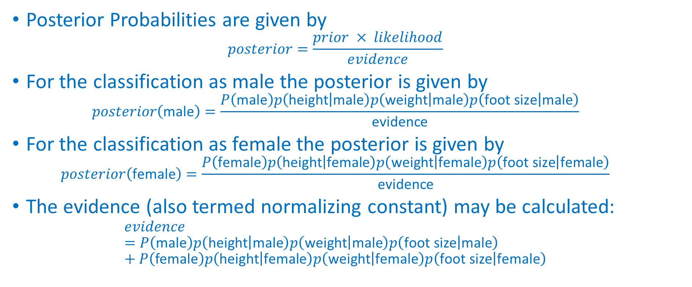
Posterior Probabilities
Posterior Probabilities are given by
$$posterior=\frac{prior × likelihood}{evidence}$$
For the classification as male the posterior is given by
$$posterior\left(\text{male}\right)=\frac{P\left(\text{male}\right)p\left(\text{height} | \text{male}\right)p\left(\text{weight} | \text{male}\right)p\left(\text{foot} \text{size} | \text{male}\right)}{\text{evidence}}$$
For the classification as female the posterior is given by
$$posterior\left(\text{female}\right)=\frac{P\left(\text{female}\right)p\left(\text{height} | \text{female}\right)p\left(\text{weight} | \text{female}\right)p\left(\text{foot} \text{size} | \text{female}\right)}{\text{evidence}}$$
The evidence (also termed normalizing constant) may be calculated:
$$evidence=P\left(\text{male}\right)p\left(\text{height} | \text{male}\right)p\left(\text{weight} | \text{male}\right)p\left(\text{foot} \text{size} | \text{male}\right)+P\left(\text{female}\right)p\left(\text{height} | \text{female}\right)p\left(\text{weight} | \text{female}\right)p\left(\text{foot} \text{size} | \text{female}\right)$$

Slide 13

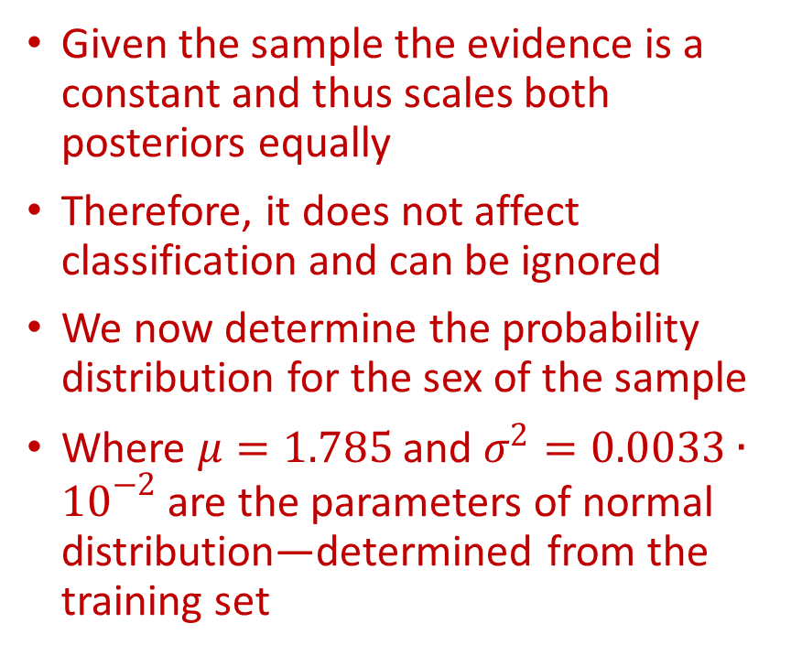
Posterior Probabilities
Given the sample the evidence is a constant and thus scales both posteriors equally
Therefore, it does not affect classification and can be ignored
We now determine the probability distribution for the sex of the sample
Where $μ=1.785$ and $σ^{2}=0.0033∙{10}^{−2}$ are the parameters of normal distribution—determined from the training set
$P\left(\text{male}\right)=0.5$
$p\left(\text{height} | \text{male}\right)=\frac{1}{\sqrt{2πσ^{2}}}\exp\left(\frac{−{\left(1.8−μ\right)}^{2}}{2σ^{2}}\right)$

Slide 14

Posterior Probabilities
Note that a value greater than 1 is OK here—it is a probability density rather than a probability, because height is a continuous variable
Since posterior numerator is greater in the female case, we predict the sample is female
$p\left(\text{weight} | \text{male}\right)=5.9881∙{10}^{−6}$
$p\left(\text{foot} \text{size} | \text{male}\right)=1.3112∙{10}^{−3}$
$posterior numerator male=their product=6.1984∙{10}^{−9}$
$p("female" )=0.5$
$p\left(\text{height} | \text{female}\right)=2.2346∙{10}^{−1}$
$p("weight" │"female" )=1.6789∙{10}^{−2}$
$p("foot size" │"female" )=2.8669∙{10}^{−3}$
$posterior numerator female=their product=5.3378∙{10}^{−4}$

Slide 15
Naïve Bayes uing R – Iris Dataset
The Iris dataset is pre-installed in R, since it is in the standard datasets package.
To access its documentation, click on ‘Packages’ at the top-level of the R documentation, then on ‘datasets’ and then on ‘iris’.
There are 150 data points and 5 variables.
Each data point concerns a particular iris flower and gives 4 measurements of the flower: Sepal.Length, Sepal.Width, Petal.Length and Petal.Width together with the flower’s Species.
The goal is to build a classifier that predicts species from the 4 measurements, so species is the class variable.
data(iris)
pairs(iris[1:4],main="Iris Data (red=setosa,green=versicolor,blue=virginica)", pch=21, bg=c("red","green3","blue")[unclass(iris$Species)])

Slide 16
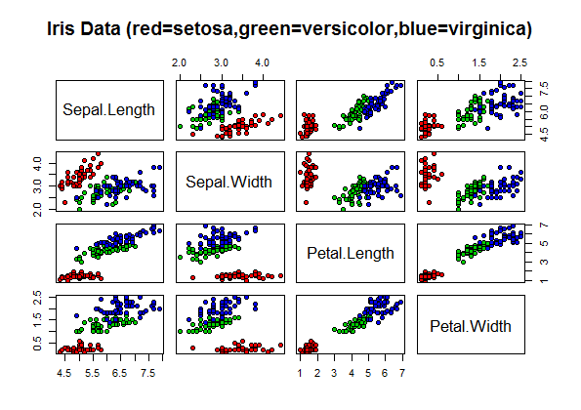
Naïve Bayes uing R – Iris Dataset
The ‘pairs’ command creates a scatterplot.
Each dot is a data point and its position is determined by the values that data point has for a pair of variables.
The class determines the color of the data point.
From the plot note that Setosa irises have smaller petals than the other two species.

Slide 17
Naïve Bayes uing R – Iris Dataset
summary(iris)
Sepal.Length | Sepal.Width | Petal.Length | Petal.Width
Min. :4.300 | Min. :2.000 | Min. :1.000 | Min. :0.100
1st Qu.:5.100 | 1st Qu.:2.800 | 1st Qu.:1.600 | 1st Qu.:0.300
Median :5.800 | Median :3.000 | Median :4.350 | Median :1.300
Mean :5.843 | Mean :3.057 | Mean :3.758 | Mean :1.199
3rd Qu.:6.400 | 3rd Qu.:3.300 | 3rd Qu.:5.100 | 3rd Qu.:1.800
Max. :7.900 | Max. :4.400 | Max. :6.900 | Max. :2.500
Species
setosa :50
versicolor:50
virginica :50

Slide 18
Naïve Bayes uing R – Iris Dataset
iris
 | Sepal.Length |  | Sepal.Width | Petal.Length | Petal.Width | Species
1 | 5.1 |  | 3.5 | 1.4 | 0.2 | setosa
2 | 4.9 |  | 3 | 1.4 | 0.2 | setosa
3 | 4.7 |  | 3.2 | 1.3 | 0.2 | setosa
4 | 4.6 |  | 3.1 | 1.5 | 0.2 | setosa
5 | 5 |  | 3.6 | 1.4 | 0.2 | setosa
-----------------------------Data omitted-------------------------
149 |  | 6.2 | 3.4 | 5.4 | 2.3 | virginica
150 |  | 5.9 | 3 | 5.1 | 1.8 | virginica

Slide 19
Naïve Bayes uing R – Iris Dataset
#INPUT
library(e1071)
classifier<-naiveBayes(iris[,1:4], iris[,5])
table(predict(classifier, iris[,-5]), iris[,5], dnn=list('predicted','actual'))
#OUTPUT
predicted setosa versicolor virginica
setosa 50 0 0
versicolor 0 47 3
virginica 0 3 47
R-Package e1071 provides functions for
latent class analysis,
short time Fourier transform,
fuzzy clustering,
support vector machines,
shortest path computation,
bagged clustering,
naive Bayes classiﬁer,
...

Slide 20
Naïve Bayes uing R – Iris Dataset
classifier$apriori
iris[, 5]
setosa versicolor virginica
50 50 50
Navïe Bayes classifier and Apriori algorithm
Navïe Bayes is considered as one of the most effectual and significant learning algorithms for ML
Also has been treated as a core technique in information retrieval
he Apriori algorithm employs level-wise search for frequent itemsets and association rulles

Slide 21
Naïve Bayes uing R – Iris Dataset
classifier$tables$Petal.Length
Petal.Length
iris[, 5] [,1] [,2]
setosa 1.462 0.1736640
versicolor 4.260 0.4699110
virginica 5.552 0.5518947

Slide 22
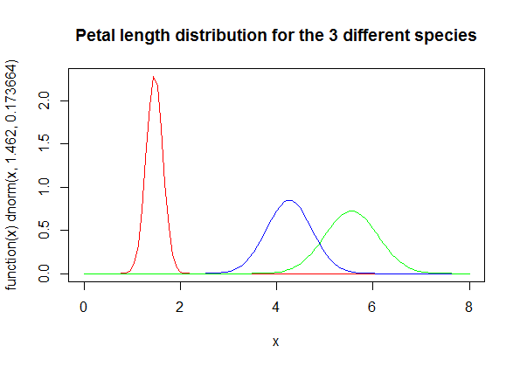
Naïve Bayes uing R – Iris Dataset
plot(function(x) dnorm(x, 1.462, 0.1736640), 0, 8, col="red", main="Petal length distribution for the 3 different species")
curve(dnorm(x, 4.260, 0.4699110), add=TRUE, col="blue")
curve(dnorm(x, 5.552, 0.5518947), add=TRUE, col="green")

Slide 23
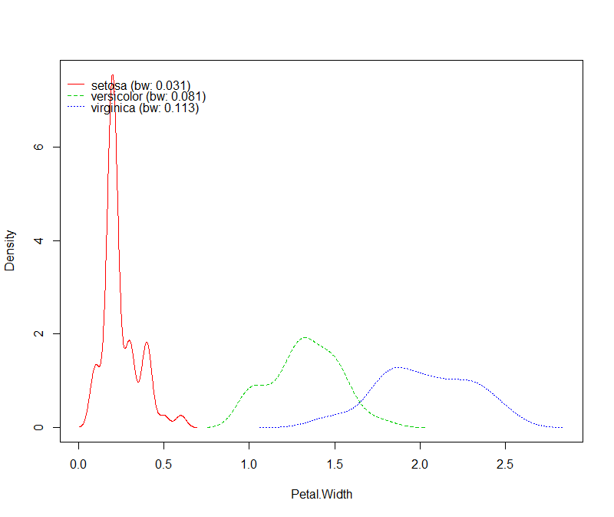
Naïve Bayes Kernel
> nb_kernel <- naive_bayes(x = iris[-5],
y = iris[ ,5], usekernel = TRUE)

Slide 24
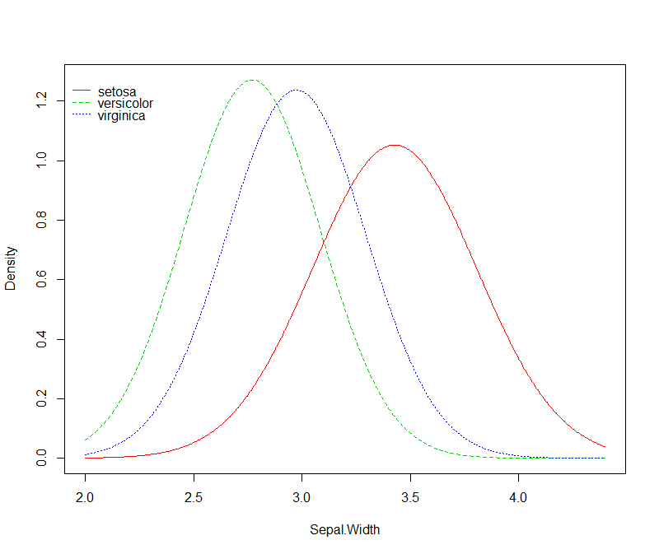
iris2 <- cbind(iris, New = sample(letters[1:3], 150, TRUE))
nb <- naive_bayes(Species ~ ., data = iris2)
plot(nb, ask = TRUE)
plot(nb, which = c(1, 2), ask = TRUE, arg.num = list(col = 1:3, lty = 1, main = "Naive Bayes Plot"))
plot(nb, which = "New", arg.cat = list(color = 4:7))

Slide 25
Crime Linkage by Similarity
Hierarchical clustering is an algorithmic approach to crime series cluster analysis that sequentially forms a hierarchy of cluster solutions.
The agglomerative approach starts with every observation (e.g., crime incident) in its own cluster.
Then it sequentially merges the two closest clusters to form a new larger cluster.
This process is repeated until all observations are in the same cluster or a stopping criterion is met.

Slide 26
crimelinkage R-Package
The crimelinkage package provides the function crimeClust_hier() for agglomerative hierarchical crime clustering
It uses the log Bayes factor as the pairwise similarity measure
That is, the similarity between crimes i and j is the estimated Bayes factor for linkage

Slide 27
Clustering Unsolved Crimes
In this example, we will cluster all of the unsolved crimes from crimes data and display dendrogram of results with plot_hcc() function.
#-- Get unsolved crimes
unsolved = subset(crimes, !crimeID %in% seriesData$crimeID)
#-- Run agglomerative hierarchical crime clustering
tree = crimeClust_hier(unsolved,varlist,estimateBF,
linkage='average’,
binary=TRUE)
#-- Plot results in dendrogram using plot_hcc()
plot_hcc(tree,yticks=seq(-2,6,by=2),type="triangle",hang=.05,
main="Average Linkage")

Slide 28
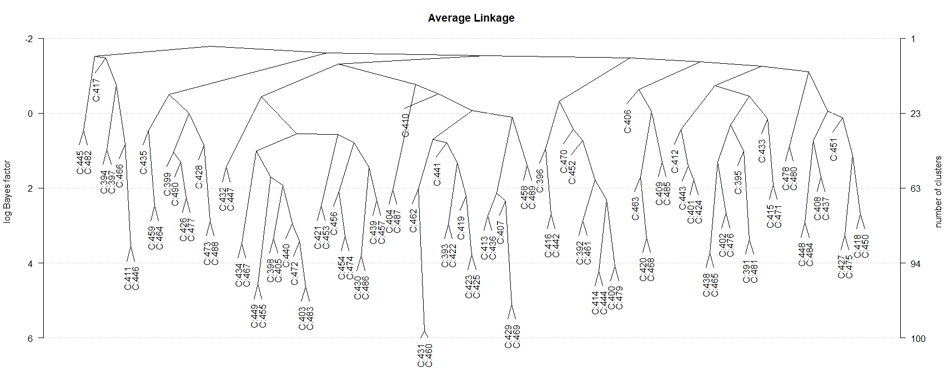
Dendrogram using Average Linking
The dendrogram (using average linkage) merges 5 crime pairs with a log Bayes factor of more than 4.

Slide 29
Examine Crimes C:431 and C:460
> subset(crimes,crimeID %in% c('C:431','C:460'))
Examining the crimes C:431 and C:460 (which were the most similar), we can see they are close in space, around 2 weeks apart in time, and have matching values for MO1, MO2, and Mo3.
crimeID X Y MO1 MO2 MO3 DT.FROM DT.TO
431 C:431 7097.0 -10256.8 26 a D 1993-10-23 22:00:00 1993-10-24 06:00:00
460 C:460 7195.3 -10624.8 26 a D 1993-11-07 03:10:00 1993-11-07 03:10:00

Slide 30
ClusterPath
If there is a particular crime of interest, then the function clusterPath() will find the sequence of merges and scores for the event.
This shows that crime C:429 first get grouped with crime C:469 with a log Bayes factor of 4.82. Then this pair gets grouped with C:413, C:436 with an average log Bayes factor of 2.13.
> cp = clusterPath('C:429',tree)
> # only return path for scores > 0
> cp[cp$logBF > 0,]
logBF crimes
1 5.1074735 C:469
2 2.3400814 C:407
3 2.1364088 C:413, C:436
4 0.1009954 C:458, C:489

Slide 31
Hierarchical Based Crime Series Linkage
This approach to crime series identification compares an unsolved crime to every crime in criminal incident database and calculates its similarity as the log Bayes factor (according to the model developed for case linkage).
Then it aggregates the similarity scores over the crime groups using single, complete, or average linkage.
Single linkage uses the largest score (most similar crime) from each group
Complete linkage uses the smallest score (least similar crime) from each group
Average linkage uses the average score as the group score.

Slide 32
Example
To give an example, extract the solved and unsolved crimes from the crimes data.
solved = subset(crimes, crimeID %in% seriesData$crimeID)
unsolved = subset(crimes, !crimeID %in% seriesData$crimeID)

Slide 33
Second Unsolved Crime – c:392
The function seriesID() can be used to find the most similar crime series to the unsolved crime.
> crime = unsolved[2,]
> # use the 2nd unsolved crime C:392
> crime
crimeID X Y MO1 MO2 MO3 DT.FROM DT.TO
392 C:392 12793.2 -3386.5 25 a E 1993-06-19 07:00:00 1993-06-19 07:00:00

Slide 34
Score Results
group average single complete
1 12 3.739680 3.739680 3.739680
2 154 3.637851 3.637851 3.637851
3 160 3.617055 3.617055 3.617055
4 8 3.494182 3.494182 3.494182
5 9 3.224453 3.924757 2.760956
6 10 3.224453 3.924757 2.760956
> results = seriesID(crime,
solved,
seriesData,
varlist,
estimateBF)
> head(results$score)
This shows that the unsolved crime is most similar to the crime(s) in crime group 12 with an average linkage log Bayes factor of 3.73968

Slide 35
Naïve Bayes (NB) Spatial Variables (X , Y) Analysis
> NB$spatial
from to value(X,Y) N.linked N.unlinked p.linked p.unlinked BF
1 0.000000 1.330002 [0.00,1.33] 18.92490842 408 0.39386082 0.05777996 6.8165648
2 1.330002 2.236050 (1.33,2.24] 2.58791209 515 0.07441269 0.06668887 1.1158187
3 2.236050 3.111460 (2.24,3.11] 2.35531136 519 0.06986449 0.06702191 1.0424127
4 3.111460 3.854694 (3.11,3.85] 0.57765568 522 0.03510481 0.06727170 0.5218362
5 3.854694 4.568613 (3.85,4.57] 2.47692308 516 0.07224245 0.06677213 1.0819251
6 4.568613 5.365327 (4.57,5.37] 1.87765568 520 0.06052457 0.06710517 0.9019360
7 5.365327 6.126928 (5.37,6.13] 0.35714286 521 0.03079298 0.06718843 0.4583077
8 6.126928 6.918310 (6.13,6.92] 1.16666667 525 0.04662213 0.06752148 0.6904785
9 6.918310 7.728588 (6.92,7.73] 0.04761905 526 0.02474065 0.06760474 0.3659603
10 7.728588 8.575494 (7.73,8.58] 0.00000000 526 0.02380952 0.06760474 0.3521872
11 8.575494 9.461998 (8.58,9.46] 1.04761905 525 0.04429431 0.06752148 0.6560033
12 9.461998 10.631034 (9.46,10.6] 0.19047619 523 0.02753403 0.06735496 0.4087900
13 10.631034 12.286147 (10.6,12.3] 0.00000000 526 0.02380952 0.06760474 0.3521872
14 12.286147 14.616999 (12.3,14.6] 0.00000000 527 0.02380952 0.06768800 0.3517540
15 14.616999 22.931787 (14.6,22.9] 1.26666667 522 0.04857750 0.06727170 0.7221090

Slide 36
Associated Crimes and Offenders
To get the crimes and offenders associated with these groups, just use the subset() function with the groups object:
> subset(results$groups,group=='12’)
> # most similar crime series
> subset(results$groups,group=='154')
> # 2nd most similar series
crimeID Index CS offenderID TIME group
27 C:148 148 12 O:109 1993-06-25 01:20:00 12
crimeID Index CS offenderID TIME group
205 C:304 304 154 O:237 1993-10-25 07:00:00 154

Slide 37
A series with multiple crimes
> subset(results$groups,group=='9')
crimeID Index CS offenderID TIME group
9 C:144 144 9 O:106 1993-06-20 03:27:00 9
10 C:163 163 9 O:106 1993-06-20 13:15:00 9
11 C:145 145 9 O:106 1993-06-20 01:30:00 9
12 C:164 164 9 O:106 1993-06-20 13:15:00 9
13 C:165 165 9 O:106 1993-06-20 12:45:00 9
14 C:166 166 9 O:106 1993-06-20 12:45:00 9

Slide 38
The 4th unsolved crime
We can do this for another unsolved crime
log Bayes factors are around 1, so this unsolved crime is not very similar to any other solved crimes in the crime database
Perhaps this is the start of a new crime series?
crime4 = unsolved[4,]
results4 = seriesID(crime4,solved,
seriesData,varlist,estimateBF)
head(results4$score)
group average single complete
1 136 1.5283543 1.5283543 1.5283543
2 316 1.1363833 1.1363833 1.1363833
3 37 0.8748010 0.8748010 0.8748010
4 48 0.8748010 0.8748010 0.8748010
5 206 0.5522861 0.5522861 0.5522861
6 219 0.4631613 0.4631613 0.4631613

Slide 39
Crime C:394 (the 4th unsolved crime)
It is also possible to compare a crime to all unsolved crimes to detect potential unsolved crime series
pairs = data.frame(i1=unsolved$crimeID[4]
i2=unique(unsolved$crimeID[-4]))
X = compareCrimes(pairs,unsolved,
varlist,binary=TRUE) # Evidence data
score = data.frame(pairs,logBF=estimateBF(X))
head(score[order(-score$logBF),])
There are no unsolved crimes that are very similar to this one - probably not enough evidence to link this crime to any others.
i1 i2 logBF
6 C:394 C:397 0.980062532
79 C:394 C:470 0.752385770
5 C:394 C:396 0.339529086
60 C:394 C:451 -0.007776621
69 C:394 C:460 -0.186420669
47 C:394 C:438 -0.206162572

Slide 40
Comparison
This approach also gives similar results to what was obtained from the hierarchical clustering path approach:
C429 = which(unsolved$crimeID %in% 'C:429')
pairs = data.frame(i1=unsolved$crimeID[C429],
i2=unique(unsolved$crimeID[-C429]))
X = compareCrimes(pairs,unsolved,
varlist,binary=TRUE) # Evidence data
score = data.frame(pairs,logBF=estimateBF(X))
head(score[order(-score$logBF),])
i1 i2 logBF
78 C:429 C:469 5.107474
17 C:429 C:407 2.735772
23 C:429 C:413 2.371051
45 C:429 C:436 2.287908
13 C:429 C:403 1.305843
C:429 C:393 1.261425
results from hierarchical clustering
logBF crimes
1 4.8226300 C:469
2 2.1332281 C:413, C:436
3 0.1540873 C:407, C:433

Slide 41
Partially-supervised Bayesian model
This approach is partially-supervised because
the offender is known for a subset of the events
utilizes spatiotemporal crime locations
uses crime features describing the offender's modus operandi.
The hierarchical model naturally handles complex features often seen in crime data, including :
missing data
interval censored event times
a mix of discrete and continuous variables.
Provides uncertainty assessments for all model parameters, including the relative influence of each feature (space, time, method of entry, etc.)
The model produces posterior clustering probabilities which allow analysts to act on model output only as warranted

Slide 42
Make the crime group labels for each crime
seriesData$CG = makeGroups(seriesData,method=2)
# method=2 uses unique co-offenders
group_info = unique(seriesData[,c('crimeID','CG')])
# extract the group info
A = merge(crimes,group_info,by="crimeID",all.x=TRUE)
# add group info to crimes
A = A[order(A$CG),] # order by crime group

Slide 43
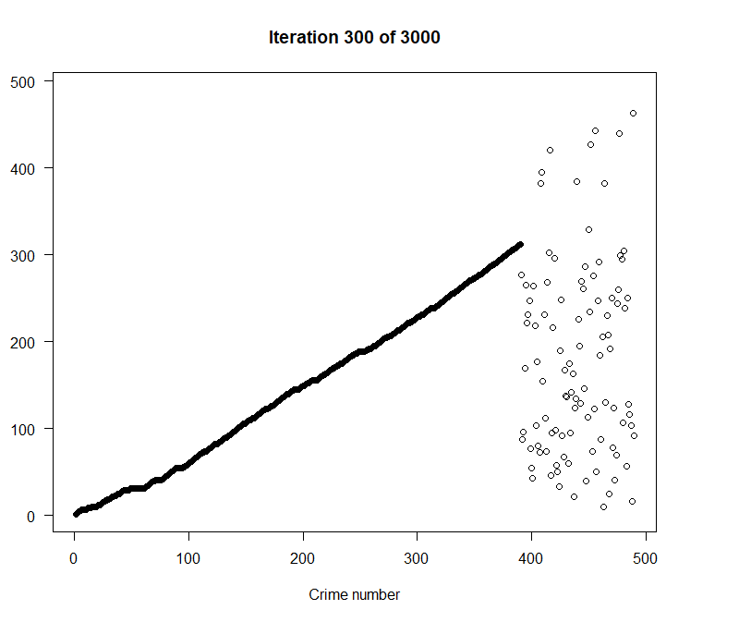
Partially-supervised Bayesian model
The function crimeClust_bayes() is used for the Bayesian model-based clustering approach
The matrix pp contains the pairwise estimated probability that two crime are linked (share a common offender).
We can use this information for crime series identification.
fit = crimeClust_bayes(A$CG, spatial=
A[,c('X','Y')],t1=A$DT.FROM,
t2=A$DT.TO,
Xcat=A[,c("MO1","MO2","MO3")],
maxcriminals=1000,
iters=3000,burn=1000,
update=100,seed=5)

Slide 44
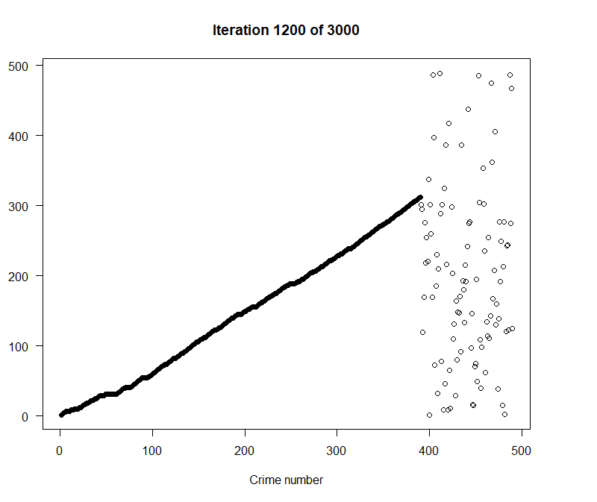
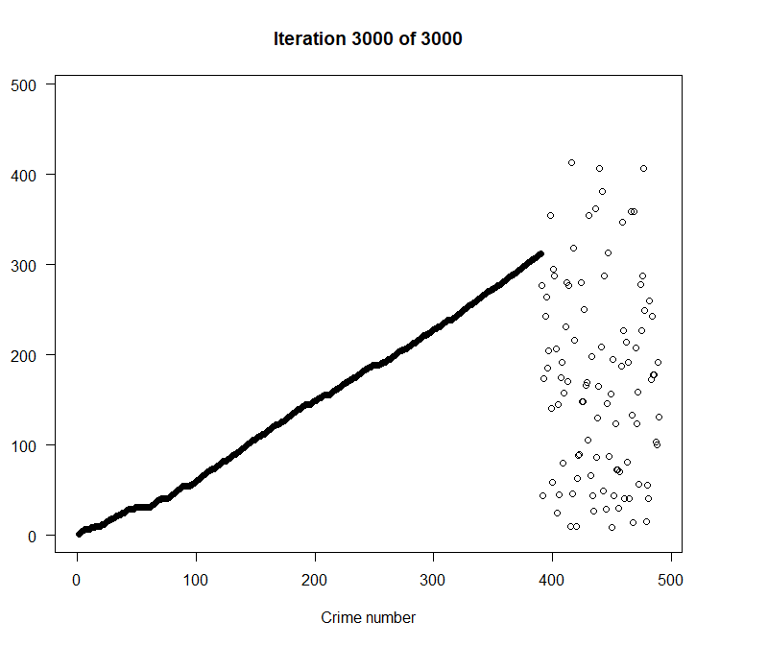

Slide 45
Results
Using the image.plot() from the fields package, we can see how strongly the unsolved crimes are linked to the existing (solved) crime series

Slide 46
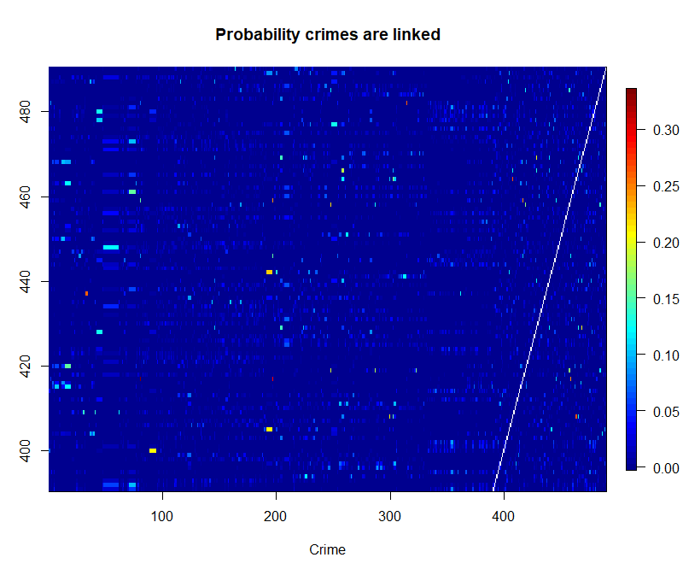
Probability Crimes are linked
We see that some unsolved crimes are linked to solved crimes with a posterior probability above 0.25. These crimes may be worth further investigations.
Using the image.plot() from the fields package, we can see how strongly the unsolved crimes are linked to the existing (solved) crime series.
library(fields)
#-- Get index of unsolved crimes
ind.unsolved = which(is.na(A$CG))
# index of unsolved crimes
n = nrow(A)
# number of crimes
#-- Image plot of linkage probabilities
fields::image.plot(1:n,ind.unsolved,
pp[1:n,ind.unsolved],
xlab="Crime",ylab="Unsolved Crime",
main="Probability crimes are linked")

Slide 47
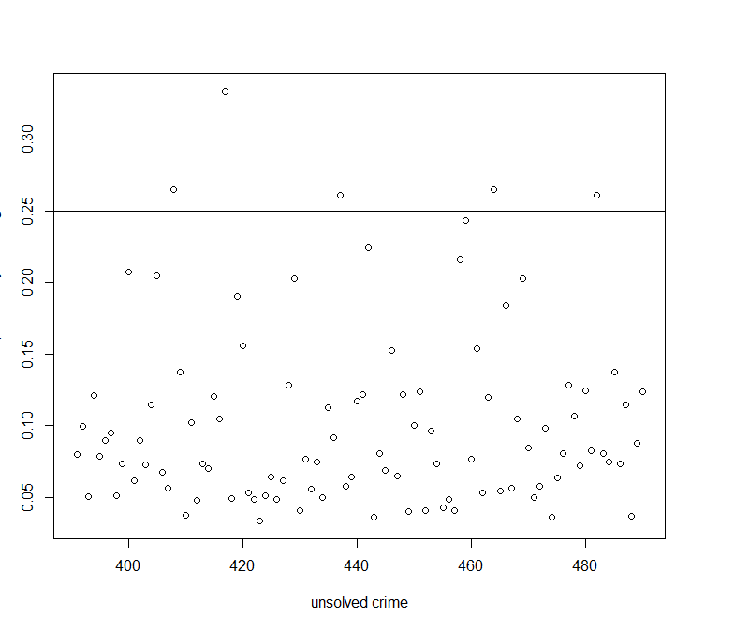
Maximum posterior probability
Here we plot the maximum posterior probability that an unsolved crime is linked to another crime (solved or unsolved)
unsolved.probs = apply(pp[ind.unsolved,],1,max,na.rm=TRUE) # maximum probability
plot(ind.unsolved,unsolved.probs,
xlab="unsolved crime",
ylab='maximum probability of linkage')
abline(h=0.25)

Slide 48
Investigate crimeIDs for crimes with strongest linkage
This shows that C:408, C:417, C:464 are the crimes with the strongest linkages (posterior probabilities greater that 0.25).
ind = ind.unsolved[unsolved.probs > 0.25]
investigate = as.character(A$crimeID[ind])
Investigate
[1] "C:408" "C:417" "C:437" "C:464" "C:482“

Slide 49
Conclusions: crimes with strongest linkage
A particular crime can be investigated in more detail with the function bayesProb():
bp = bayesProb(pp[A$crimeID %in% "C:417"])
bp$crimeID = A$crimeID[bp$index]
bp$CG = A$CG[bp$index]
head(bp)
index prob crimeID CG
1 81 0.3335 C:15 46
2 197 0.2920 C:26 146
3 459 0.2415 C:459 NA
4 446 0.0985 C:446 NA
5 2 0.0510 C:10 2
6 482 0.0400 C:482 NA
For this example, our model provides a list of the most likely crimes associated with the unsolved crime C:417.
The first two crimes (C:15 and C:26) are solved crimes indicating that the offender(s) responsible for these crimes may also be responsible for C:417.
The next two crimes, C:459 and C:446 do not have a group ID.
This means that they are unsolved crimes.
By providing the posterior probabilities, crime analysts may choose to investigate further only if the linkage is strong enough.

Slide 50
Naïve Bayes uing R – HairEyeColor
HairEyeColor
, , Sex = Male
Eye
Hair Brown Blue Hazel Green
Black 32 11 10 3
Brown 53 50 25 15
Red 10 10 7 7
Blond 3 30 5 8
, , Sex = Female
Eye
Hair Brown Blue Hazel Green
Black 36 9 5 2
Brown 66 34 29 14
Red 16 7 7 7
Blond 4 64 5 8

Slide 51
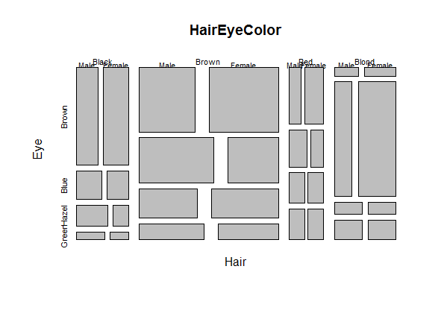
Naïve Bayes uing R – HairEyeColor
mosaicplot(HairEyeColor)

Slide 52
Naïve Bayes uing R – HairEyeColor
Sex
Male Female
279 313
Sex
Hair Male Female
Black 56 52
Brown 143 143
Red 34 37
Blond 46 81
margin.table(HairEyeColor,3)
margin.table(HairEyeColor,c(1,3))

Slide 53
www.humalytica.com
http://www.amazon.com/Jeffrey-Strickland/e/B00IQ69QZK/
http://www.lulu.com/spotlight/strickland_jeffrey

